Slide 1
Data & Information
Lecture 1

Slide 2
Introduction
What is data?
Data is a raw and unorganized fact that is required to be processed to make it meaningful. It can be considered as facts and statistics collected together for reference or analysis. Data are individual units of information
What is information?
Processed data is considered as information. Information is the knowledge that is remodeled and classified into an intelligible type, which may be utilized in the method of deciding.

Slide 3
Difference between data and information
Home Task: Write down the differences between data and information.

Slide 4
Let’s Guess
5+5=10
What are the data in this equation?
What is the information in this equation?

Slide 5
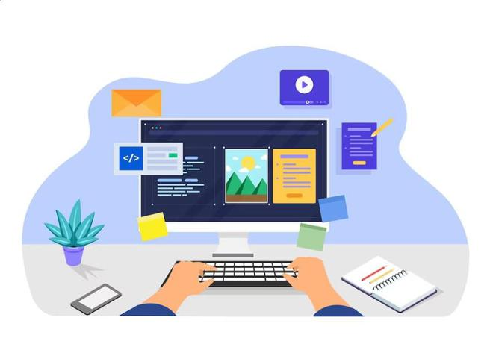
Computer
The word computer comes from the word “compute”, which means, “to calculate”
Thereby, a computer is an electronic device that can perform arithmetic operations at high speed
A computer is also called a data processor because it can store, process, and retrieve data whenever desired

Slide 6
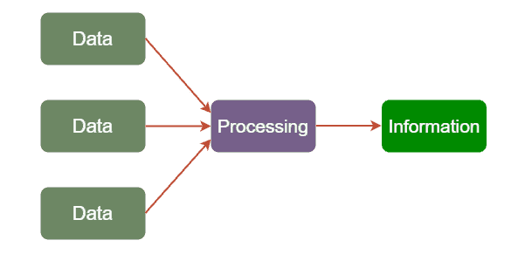
Data Processing
The activity of processing data using a computer is called data processing
Data is raw material used as input and information is processed data obtained as output of data processing

Slide 7
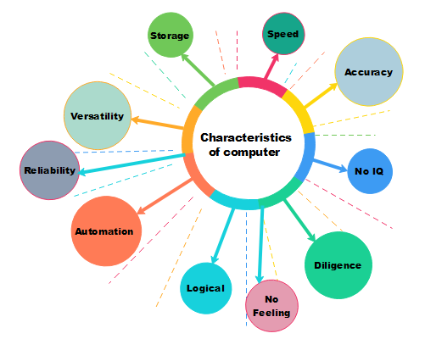
Characteristics of Computers

Slide 8
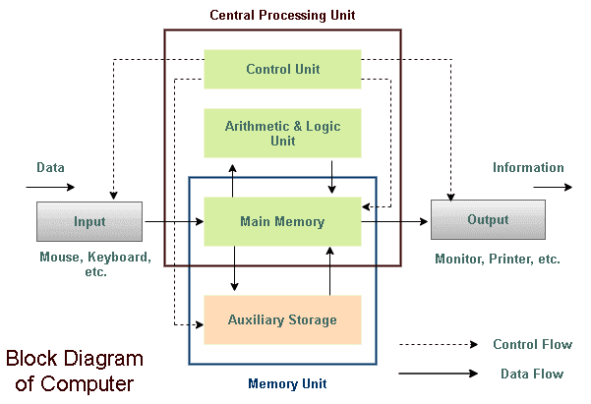
Working of a computer

Slide 9
Working of a computer
The working of a computer can be broadly categorized into following four functions or steps.
(i) Receive input – Accept data/information from user through various input devices like the keyboard, mouse, scanner, etc.
(ii) Process information–Perform arithmetic or logical operations on data/information.
(iii) Store information—Store the information in storage devices like hard disk, CD, pen drive etc.
(iv) Produce output–Communicate information to the user through any of the available output devices like monitor, printer, etc.

Slide 10
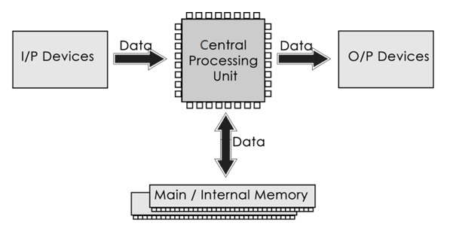
Components of a computer

Slide 11
That’s all for today………..

